Slide 1
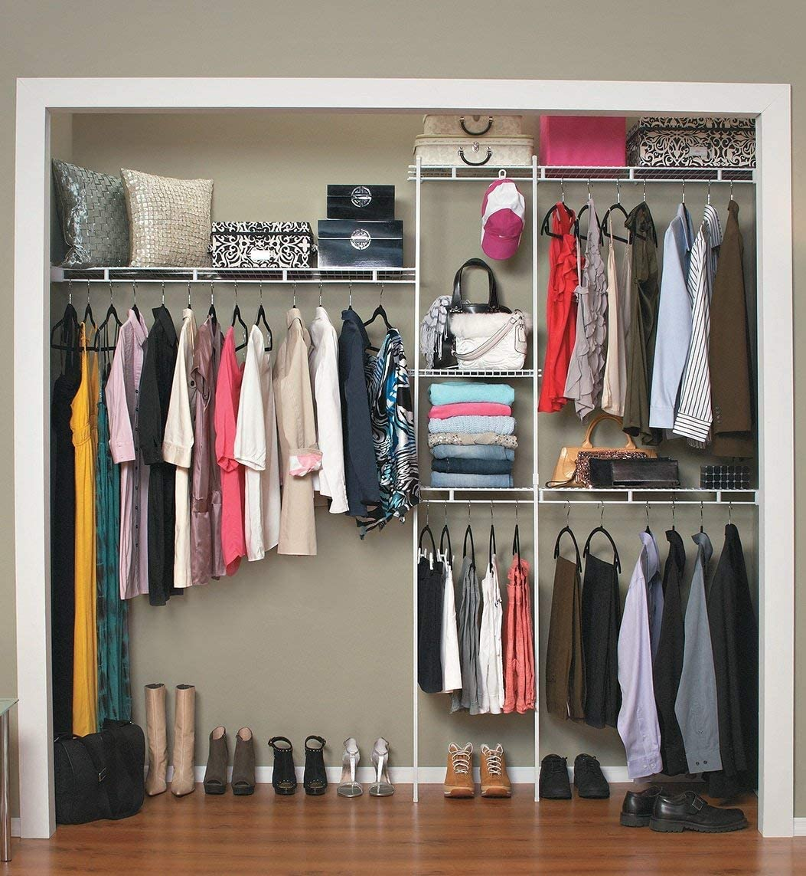

Closet App
Team P
T04 Philmo Gu

Slide 2
Team P Members
Eric Wu
Jack Yang
Sophia Ngo
Soumya Kumaria
Sydney Kwok

Slide 3
Project Idea
Virtual closet mobile application
Database for clothes and accessories
Mix and match clothing items
Allows planning of outfits on the go
Share and explore clothes with friends

Slide 4
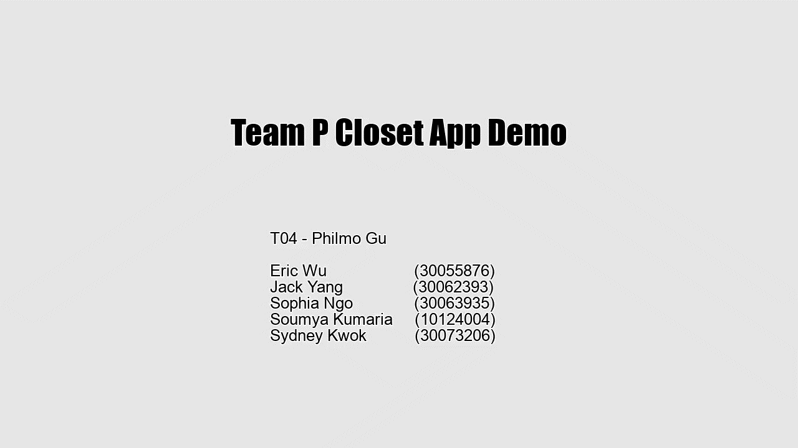
Prototype Demo

Slide 5
Stage Three Journey

Slide 6
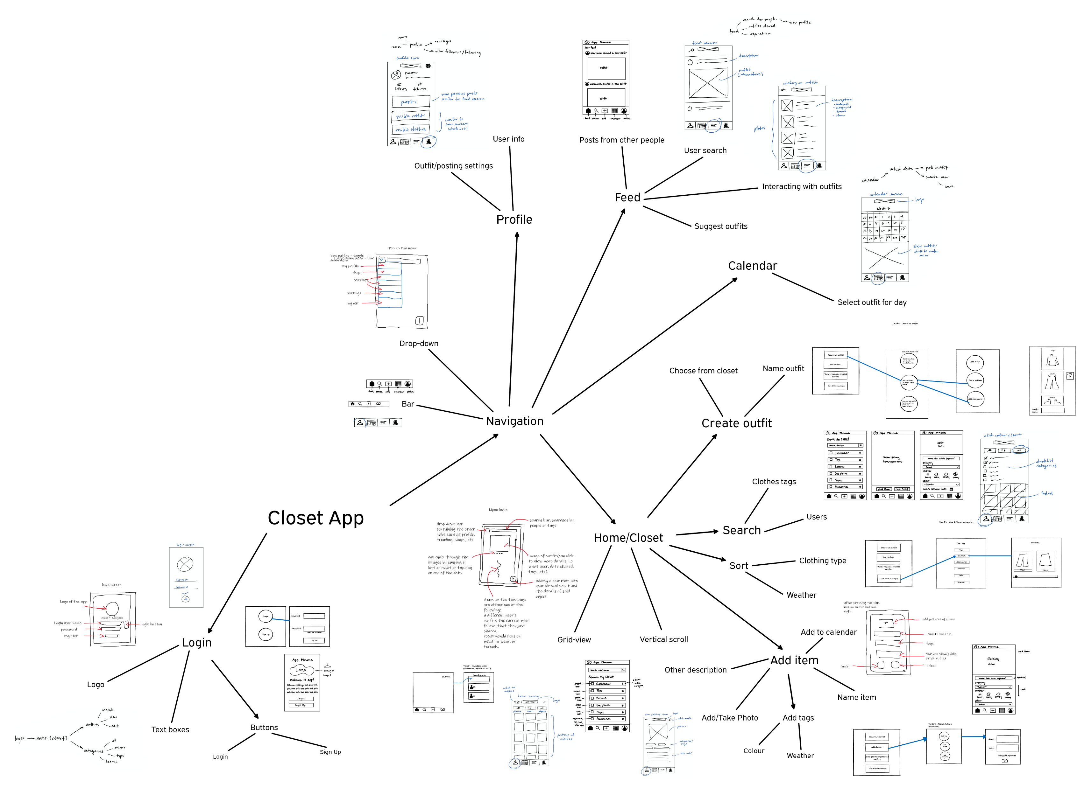
Notes:
Our affinity diagram groups together tasks and different UI screens.
Within each UI screen, there are tasks which are included in each screen.
The three ideas, we chose to refine are the home/closet screen, add item feature, and the calendar.
We prototyped these ideas vertically, while horizontally prototyping the rest.

Slide 7
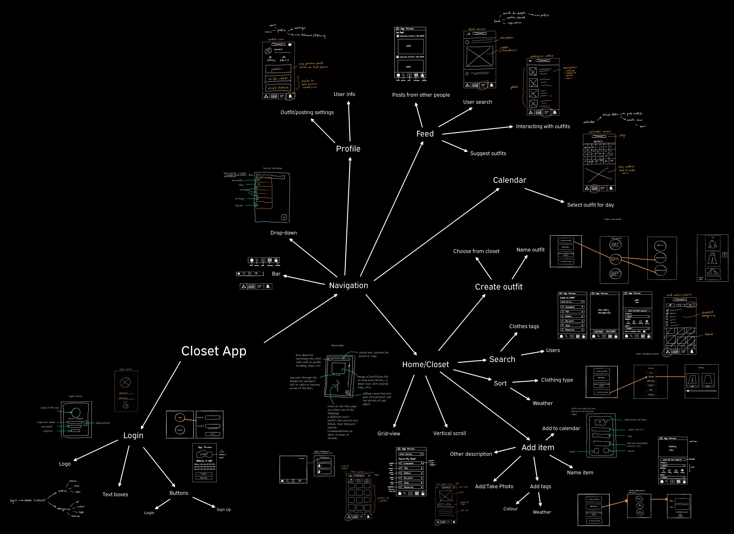
Affinity Diagram
Ideas ditched
Creating a new outfit by choosing items from previous outfits
Drop-down navigation menu
How we refined final idea
Ease of use
Notes:
After taking a look at our diagram, we decided to ditch the option of creating new outfits by choosing items from previously created outfits.
We also decided not to go forward with the drop-down menu as a way to navigate to different screens in the app.
We refined our final idea by comparing similarities and differences between various ideas.
For example, for the navigation we had two ideas, the bar and the drop-down menu.
After reviewing other apps and our goal which is to make a clean simple app, we decided on the using the bar.

Slide 8
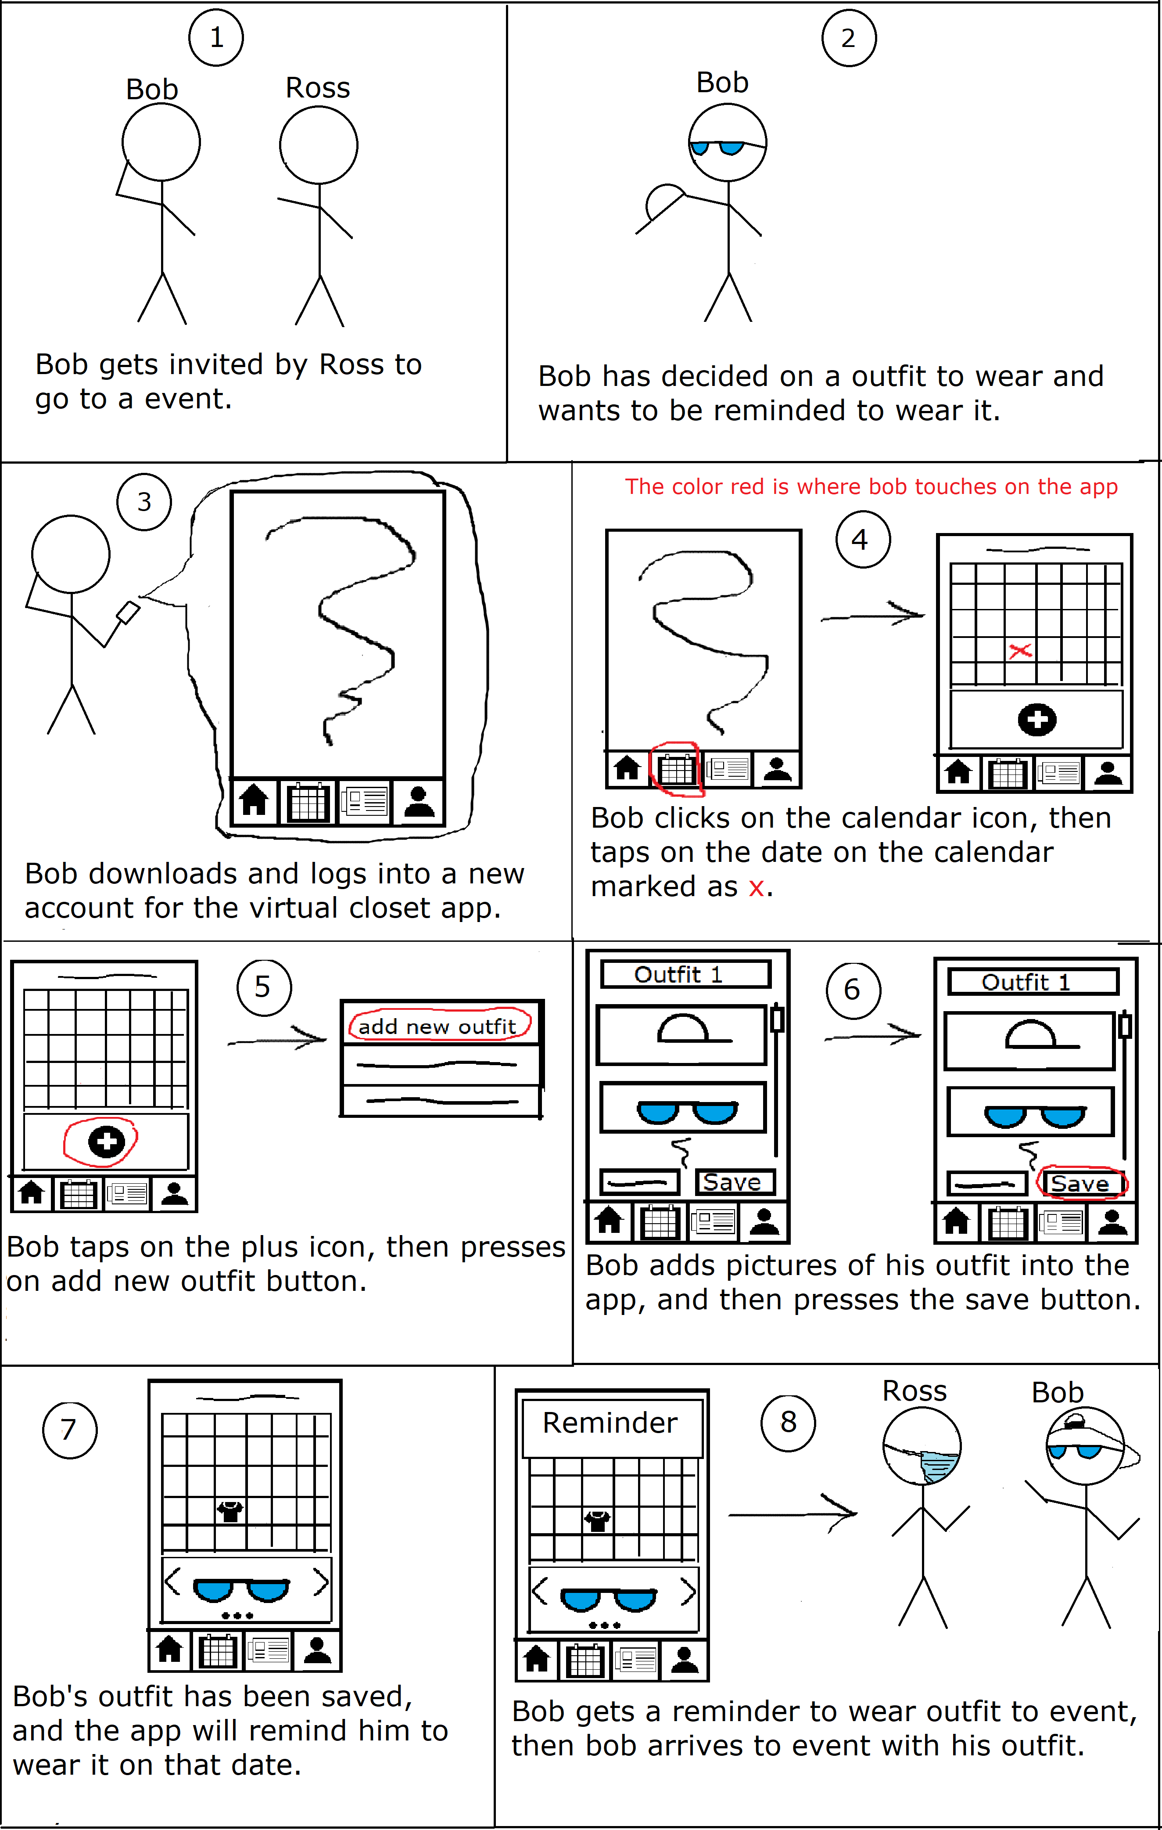
Storyboard

Slide 9
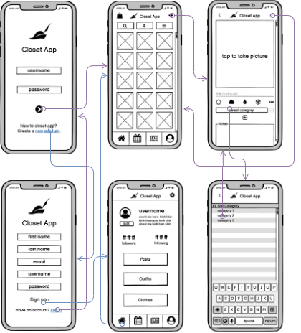
Lessons Learned Creating Low-fi Prototype
Creating new ideas from scratch
Incorporating features from user feedback
Flow between frames had to be adjusted for a simple path

Slide 10

Cognitive Walkthrough Evaluation
Long time organizing task steps
What did you change?
Title and description of outfit optional
More description in search option
Option of adding a temporary picture from photo gallery
What did you learn?
Users can be from any skill level

